Slide 1

Privacy Preserving And Trusted Keyword Search For Multi – Tenancy Cloud
GURU NANAK INSTITUTE OF TECHNOLOGY Department of Computer Science and Engineering
UNDER THE GUIDANCE OF
Mr. G. Lakpathi
Assistant professor
TEAM MEMBERS
Saurav kumar mandal - 21831A05M1
Heerekar Abhishek - 20831A0561
Deekshitha Thumma - 21831A05K9

Slide 2

Privacy-Preserving Key Word Search in Multi-Tenant Clouds
This presentation explores innovative solutions for secure cloud search, balancing data privacy and search efficiency across multiple tenants.

Slide 3

The Cloud Security Dilemma
Data Privacy Concerns
Regulatory Compliance
Multitenant clouds face significant challenges in protecting user data while allowing efficient search capabilities.
Strict data protection laws complicate cross-tenant search operations without proper safeguards.
Performance Balancing
Implementing strong encryption can lead to significant performance degradation in search operations.

Slide 4




Innovative Abstraction
1
Multi-Tenant Environment
2
Encrypted Data Storage
3
Searchable Encryption
4
Trusted Execution Environments
This hierarchical approach ensures data protection while maintaining search functionality across cloud platforms.

Slide 5
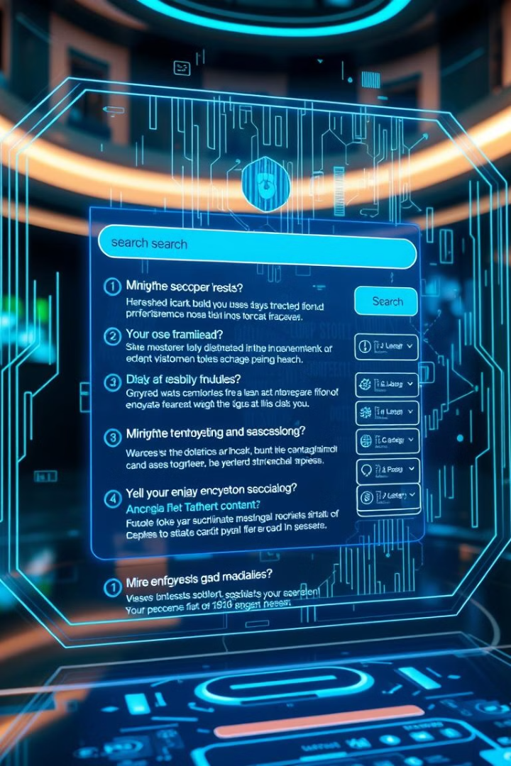


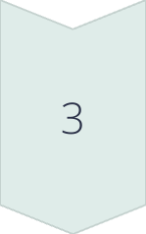
Project Objectives
Develop Encrypted Search Algorithm
Create a search method that works efficiently with encrypted data.
Protect Individual Tenant Data
Ensure that each tenant's data remains confidential during searches.
Enhance Overall Cloud Security
Improve the security of multi-tenant cloud environments without sacrificing performance.

Slide 6





Technology Stack
Advanced Encryption
Cloud Computing
Utilizing state-of-the-art cryptographic algorithms for data protection.
Leveraging scalable cloud infrastructure to manage large datasets.
Trusted Execution Environments
Hardware Acceleration
Using specialized hardware to speed up cryptographic operations.
Implementing secure enclaves for sensitive operations on encrypted data.

Slide 7
Our Revolutionary Approach
Encrypted Search Queries
Tenant Isolation
Efficient Indexing
Developing algorithms that allow meaningful searches without decrypting the data.
Creating virtual boundaries to prevent cross-tenant data leaks during searches.
Implementing indexing techniques that work seamlessly with encrypted data.

Slide 8

Impressive Experimental Results
98%
37%
Query Accuracy
Latency Increase
Nearly perfect match between encrypted and decrypted search results.
Minimal performance impact compared to unencrypted search.
0%
Data Leaks
No breaches or unintentional data exposure during testing.

Slide 9



Real-World Applications
Healthcare
Finance
Government
Securely search encrypted patient records across multiple hospitals without exposing sensitive data.
Analyze encrypted financial data from various sources with strict privacy controls for each tenant.
Perform cross-agency searches on classified information without breaching agency boundaries.

Slide 10

Key Takeaways
1
Privacy-Preserving Search
Our solution enables efficient search on encrypted data without exposing sensitive information.
2
Multitenant Compatibility
Tenants can search across shared environments while maintaining data isolation.
3
Future-Ready Technology
Our approach sets a new standard for secure cloud computing and data search.

Slide 11

Next Steps
Further Testing
Standardization Efforts
Expand real-world testing across multiple industries and cloud providers.
Work towards industry-wide standards for encrypted cloud search.
Global Implementation
Launch pilot programs with major cloud service providers.

